Slide 1

Database Systems (Fall 2021) Project Campus Eats Team and Members DB-Group -4 Thanh Phan Mai Lee Ouchithya Bollu Vaishnavi Mahesha
Notes:
Introduction: Hey Everyone! This presentation is for the Deliverable 3. Database Systems Fall 2021 Project. The team members are: Thanh, Mai, Ouchithaya and Vaishnavi. The Goal for this project to come up with delivery system that will allow students to order food and get food delivered to approved drop off locations at UNCC:

Slide 2
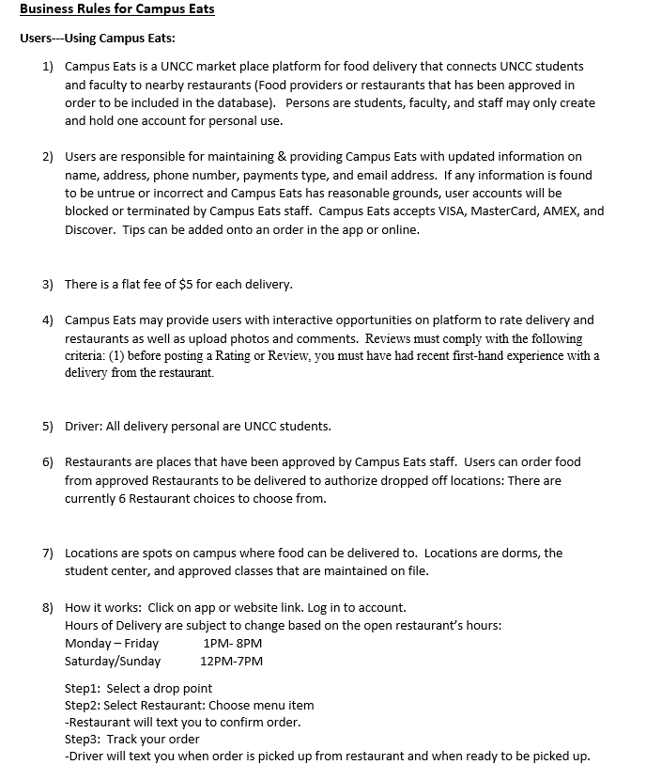
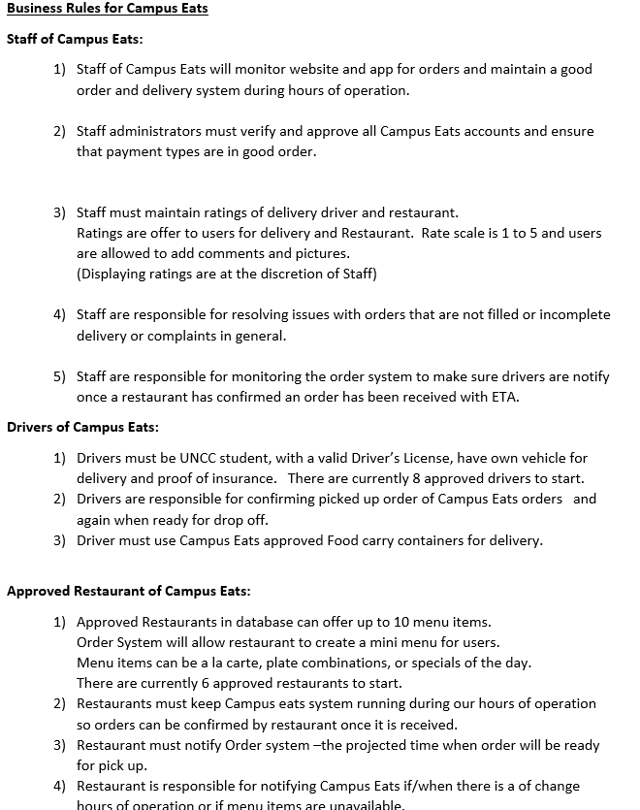
Business Rules for Campus Eats
Notes:
There are three sets needed as in any business. You must practice safety and understand how everything is connected in order to stay in business.

Slide 3
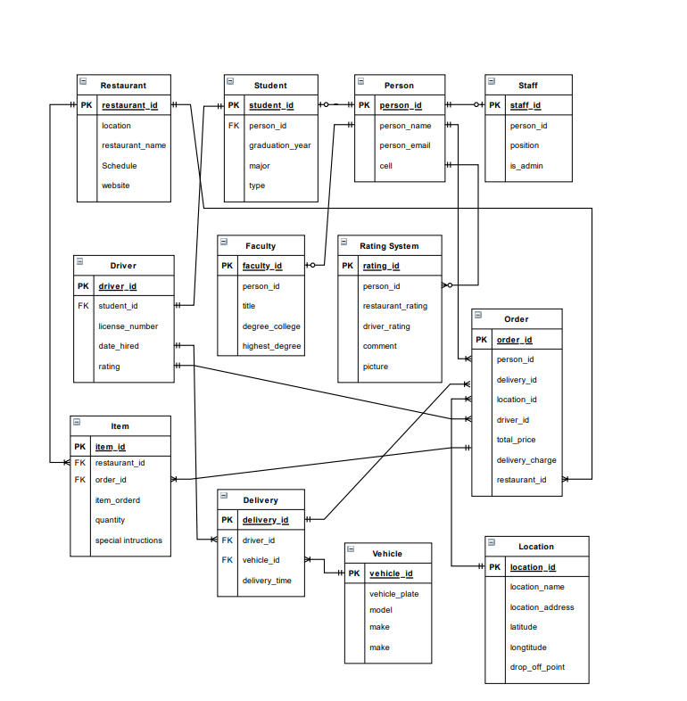
EERD Diagram
Notes:
Our EERD diagram shows/displays how our tables are connected and related to each other. With the given data. We had to create two new tables:

Slide 4
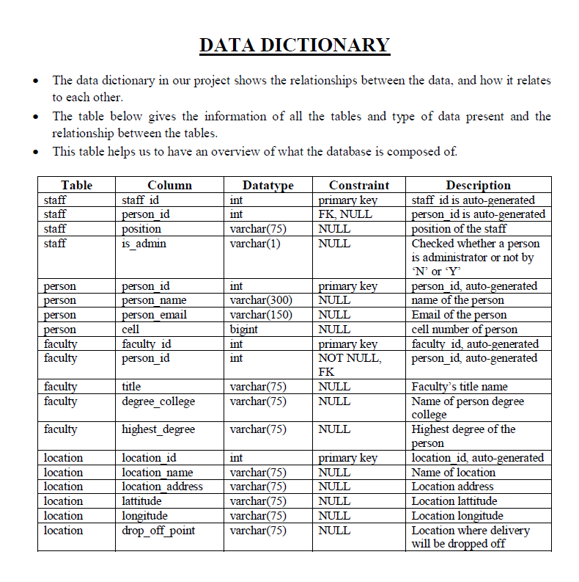
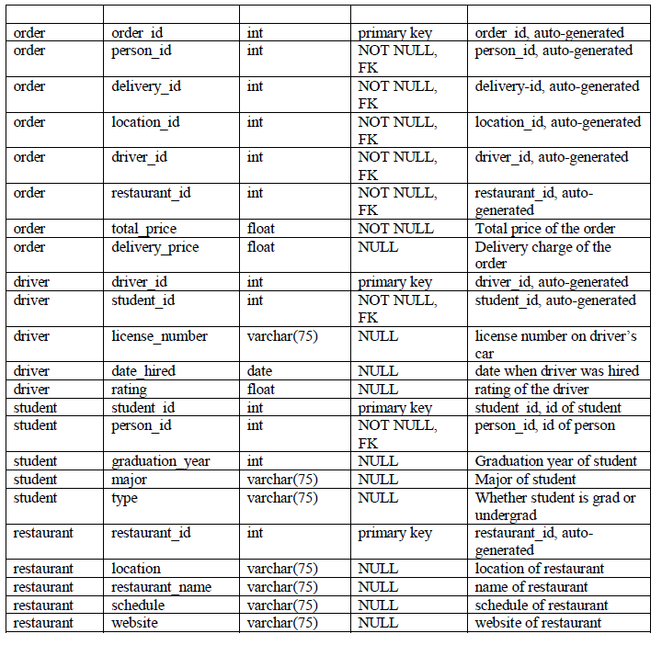
Notes:
A Data Dictionary is a collection of names, definitions, and attributes about data elements that are being used or captured in a database, information system, or part of a research project. ... A Data Dictionary also provides metadata about data elements.

Slide 5
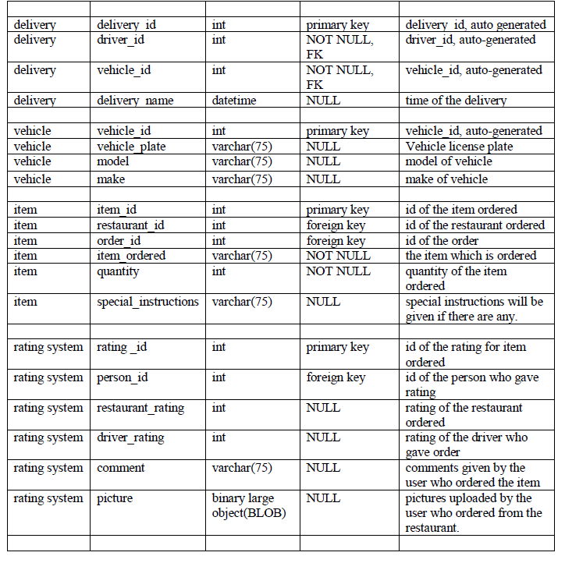
DATA DICTIONARY -continued

Slide 6
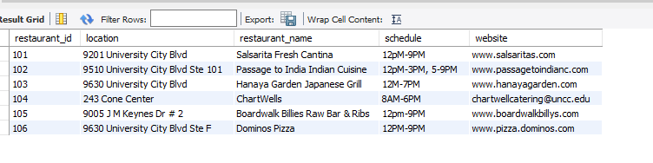





This is a list of the approved restaurants that we have in our database

Slide 7
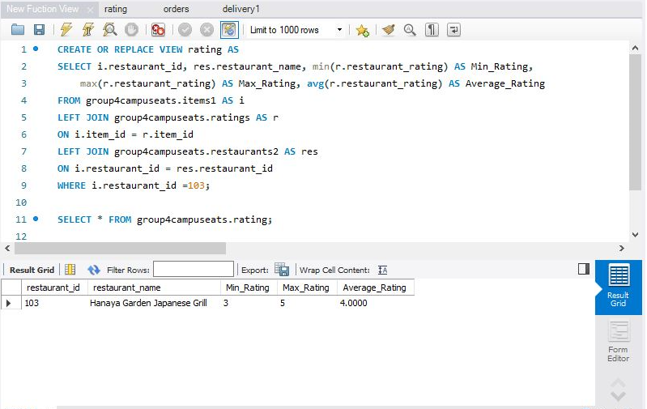
Calculating AVG, MIN, MAX of ratings for a restaurant id as a View
Notes:
The two new tables that we created were ratings for delivery & restaurant with and a menu items detailing what the customers ordered.

Slide 8
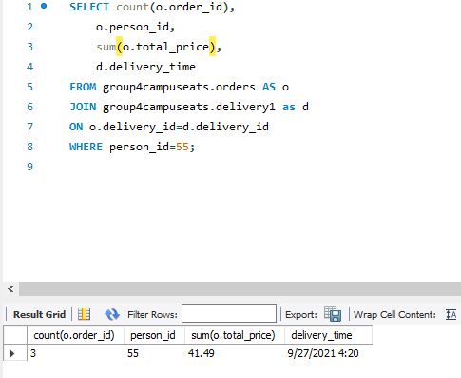
Count orders when given person id and date selected

Slide 9
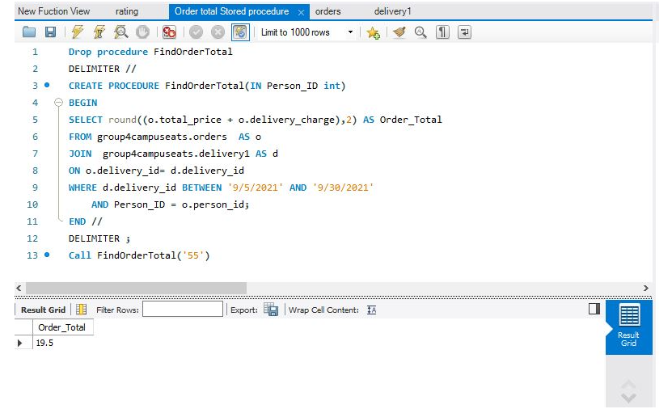
Total ordered listed by a specific person as a Stored Procedure

Slide 10
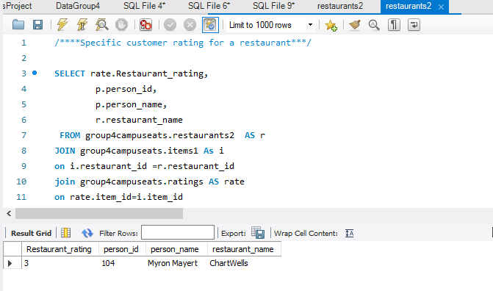
Specific customer rating for a restaurant

Slide 11
Thanks for watching!
Thanh Phan Mai Lee Ouchithya Bollu Vaishnavi Mahesha
Notes:
We learned a lot through this Deliverable Database project thru managaing the dataset. We are sure that if the service was made available to UNCC students, it would be an added benefit. Thanks for listening and watching our presentation.

